Slide 1
Monochromatic Paintings
Name
Institution of Affiliation

Slide 2
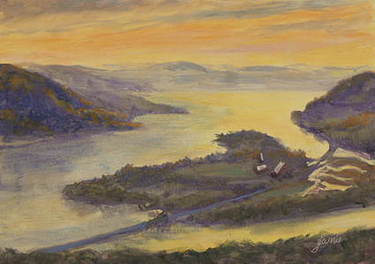
Sunrise Glare on the Hudson Valley- by Jammie Williams
This painting by Jammie is one of his artworks. It was painted while he was on top of a hill early in the morning. Jammie liked the beautiful reflection from the valley and the open sky.

Slide 3
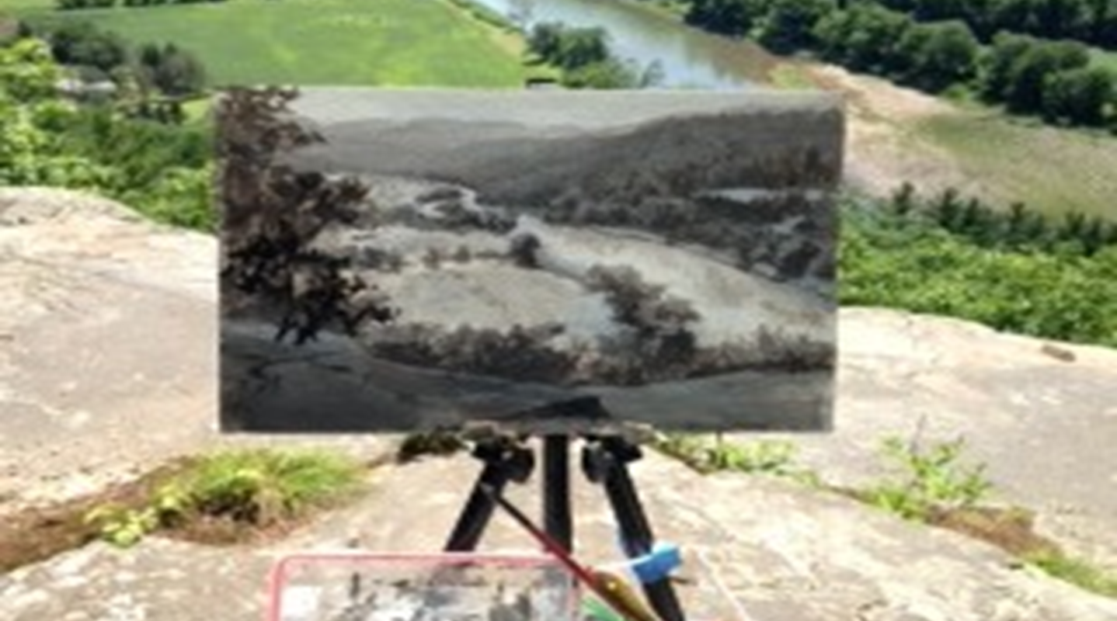
Schoharie Creek Scene- by jammie Williams
The painting of Schoharie Creek Scene from a raised ground. The beauty of the nature is displayed in the surrounding trees and the river.

Slide 4
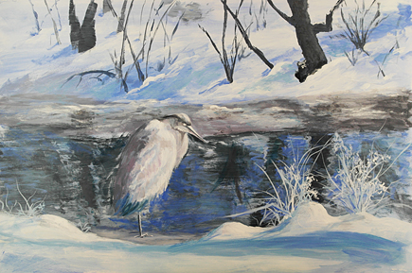
The great blue heron- by Jammie Williams
This is a picture of a bird that that was taken during the winter season early in the morning and painted. It represents the feeling of being in a winter weather as displayed by the bird and the surroundings.

Slide 5
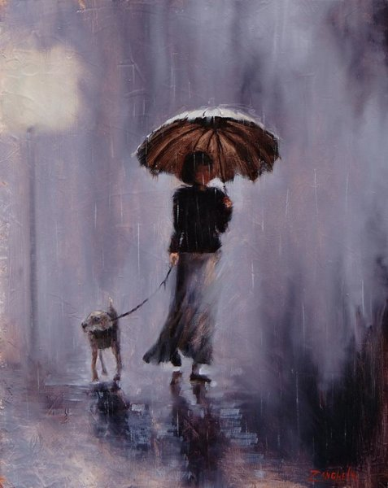
In the rain or shine- by Laura Lee Zanghatti
This painting by Laura shows a woman with a strong relationship with her dog. It also portrays love for the nature.

Slide 6
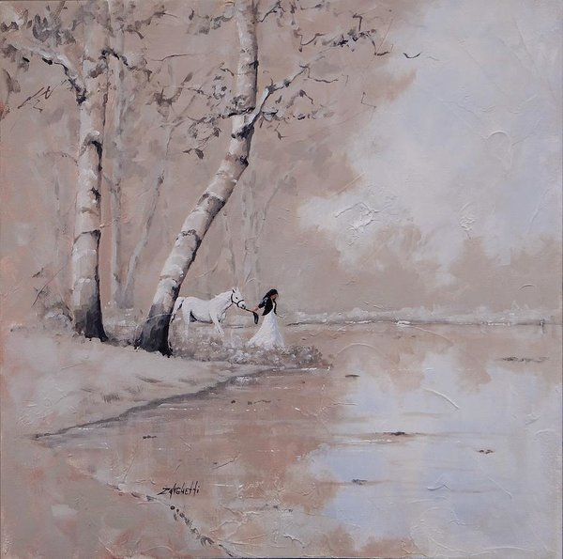
Was It a Dream– by Laura Lee Zanghatti
Another painting by Laura showing a woman pulling her horse. The title given to the painting could be an indication that the artist was imagining the picture or was wondering if such a beautiful woman would exist.

Slide 7
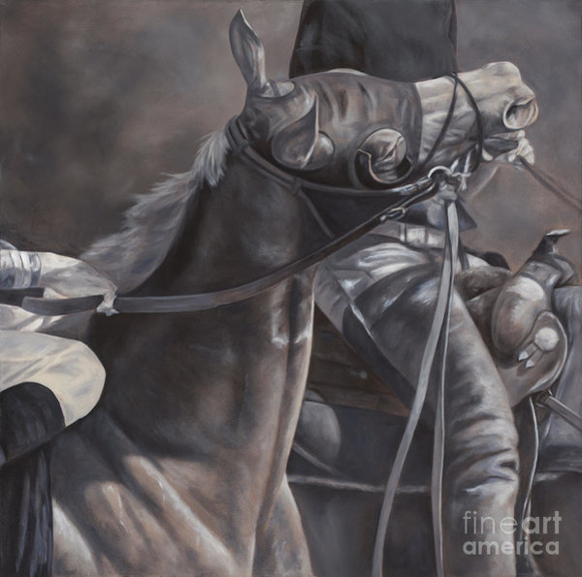
Toss- by Linda Shantz
The painting of two horses. One horse is driven while the other is pulled by the other horse. It is a reflection on the relationships between man and animals especially those domesticated.

Slide 8
Notes
The first three paintings are artworks by Jammie Williams. His paintings majorly focuses on nature which shows how he is in love with the beauty of nature.
The other two Paintings belongs to the American Laura Lee. The paintings have of people with their animals. This shows that the artist liked domesticated animals so much that the artist called one of the painting ‘In Rain or Sunshine’.
The painting is of Linda. From the look of the paint, the man is struggling with two horses. It seems Linda too likes animals as seen from her works.
The importance of monochromatic paintings is that it represents the aspirations and message on what the artist wish to communicate to the world.

Slide 9
References
www.fineartamerica.com/art/paintings/monochromatic
www.husonvalleypainter.com

